Slide 1
PRD Genie
AI-Powered Product Documentation Assistant
Capstone Project Prepared by Mahesh Zade
PRD Genie | Mahesh Zade | 1

Slide 2
Executive Summary
Transforms transcripts/notes into grounded product documentation
Sequential LangFlow pipeline: Extract → PRD → Stories
Gap Analysis identifies unresolved questions
Langfuse provides observability
PRD Genie | Mahesh Zade | 2

Slide 3
Problem Statement
Manual transcript-to-PRD work
Inconsistent documentation formats
Requirements get lost in notes
Manual Epic/User Story breakdown
Risk of AI inventing requirements
PRD Genie | Mahesh Zade | 3

Slide 4
Target User & Workflow
Primary user: PM / TPM
Input: transcript, notes or product brief
Current: read → interpret → document → clarify
Target: source → structured output → human review
PRD Genie | Mahesh Zade | 4

Slide 5
Objectives
Improve extraction completeness
Standardize PRD structure
Create traceable stories
Surface ambiguity and contradictions
Measure quality and cost
PRD Genie | Mahesh Zade | 5

Slide 6
Solution
Grounded AI documentation assistant
Single responsibility per agent
UNKNOWN/TBD instead of invention
Reviewable consolidated output
PRD Genie | Mahesh Zade | 6

Slide 7
Requirement Extraction
Stated requirements
NFRs and constraints
Stakeholders/roles only when stated
Deadlines
Ambiguity, contradictions and dependencies
Source evidence
PRD Genie | Mahesh Zade | 7

Slide 8
PRD Generation
Extraction is sole source of truth
Structured PRD
Exact acceptance criteria
No invented personas/goals/metrics
Open questions retain unresolved items
PRD Genie | Mahesh Zade | 8

Slide 9
Story Breakdown
Epics → Features → User Stories
Traceability to PRD requirements
Required As-a-user format
No new scope
Priority handling
PRD Genie | Mahesh Zade | 9

Slide 10
Gap Analysis
Extended capability
Targets explicit gaps and contradictions
Direct stakeholder questions
No generic filler questions
No proposed answers
PRD Genie | Mahesh Zade | 10

Slide 11
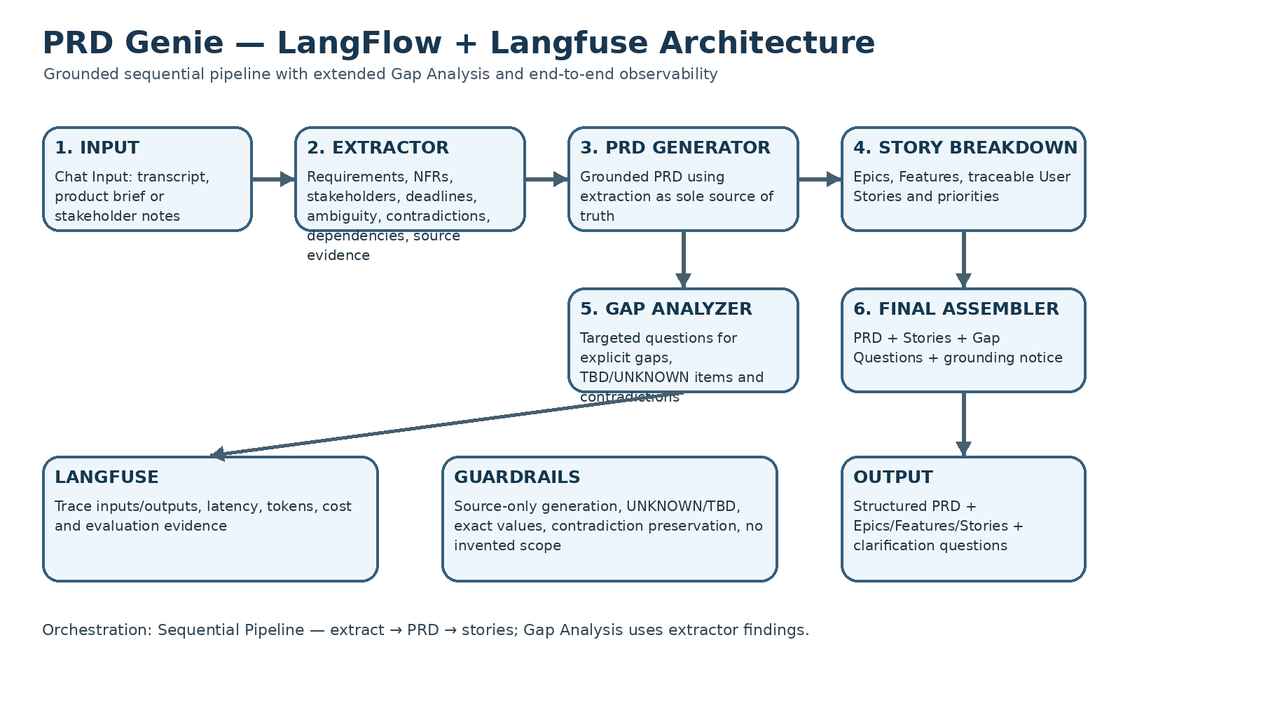
Architecture
Chat Input
Requirement Extractor
PRD Generator
Story Breakdown
Gap Analyzer
Final Assembler + Langfuse
PRD Genie | Mahesh Zade | 11

Slide 12
Orchestration Choice
Sequential Pipeline matches fixed PRD Genie flow
Simple to debug
Deterministic stage order
Matches capstone guidance
Avoids unnecessary routing complexity
PRD Genie | Mahesh Zade | 12

Slide 13
Agent Responsibilities
Extractor: facts + evidence
PRD: structured document
Stories: traceable delivery artifacts
Gap Analyzer: decision questions
Assembler: final specification
PRD Genie | Mahesh Zade | 13

Slide 14
Grounding Guardrails
Only source-stated information
No role inference
No discussion-to-requirement conversion
Exact values preserved
Contradictions preserved
UNKNOWN/TBD enforced
PRD Genie | Mahesh Zade | 14

Slide 15
LangFlow Implementation
Prompt Template components
OpenAI model nodes
Connected variables: transcript, extraction, prd, stories, gaps
Final Chat Output
Visual sequential flow
PRD Genie | Mahesh Zade | 15

Slide 16
Langfuse Observability
Trace per run
Agent input/output inspection
Latency
Tokens
Cost
Before/after prompt evaluation
PRD Genie | Mahesh Zade | 16

Slide 17
Baseline Dataset
12 tests
Detailed, vague, contradictory, incomplete and empty cases
Technical requirements and dependencies
T11/T12 downstream tests
PRD Genie | Mahesh Zade | 17

Slide 18
T1–T12: 12/12 PASS (100%)
Grounded extraction and PRD generation validated
Ambiguity, contradictions and insufficient inputs handled
NFRs excluded from story generation
Persona fidelity and traceability validated
T11 → T12 downstream checks passed
T1/T3/T5/T10 still fail in the latest run
T2 passes the focused gap-question check
T4/T6/T7/T8 show unsupported generated content
T9 incorrectly creates a PRD from empty notes
Final Baseline Validation
PRD Genie | Mahesh Zade | 18

Slide 19
Source-only generation and evidence grounding
Generic actor ≠ formal persona
Explicit personas mapped to stories
Performance / capacity / concurrency stay NFRs
TBD / UNKNOWN and dependencies preserved
No invented acceptance criteria, benefits or scope
Latest export sends Prompt Template output as system_message
Actual source data is not routed into each LLM input_value
This explains the repeated 'No requirements extractable' behavior
Corrected export adds direct data routing
Prompt Hardening — What Changed
PRD Genie | Mahesh Zade | 19

Slide 20
Final-run Langfuse screenshots supplied
Trace shows Chat Input → Prompt Templates → OpenAI generations → Chat Output
Latency and cost fields are visible per trace
Observed sample trace: ~7.26s and $0.001684
Use representative traces for production cost estimates
Chat Input → Extractor LLM input
Extractor → PRD Generator input
PRD Generator → Story Breakdown input
Extractor → Gap Analyzer input
Re-run T1–T12 and validate in Langfuse
Langfuse Evidence
PRD Genie | Mahesh Zade | 20

Slide 21
Evaluation Metrics
Extraction completeness
Hallucination rate
Format compliance
Latency and cost as operational metrics
PRD Genie | Mahesh Zade | 21

Slide 22
Cost Analysis
Langfuse provides observed token/cost evidence
Sample displayed trace: ~$0.001684 total cost, ~7.26s
Production formula: cost/run × runs/day × 30
Do not treat one trace as a universal cost
ROI deck separates illustrative assumptions from measured ROI
PRD Genie | Mahesh Zade | 22

Slide 23
ROI & Business Impact
Time saved
Standardization
Reduced requirement loss
Faster engineering handoff
Traceability
Use measured pilot data for monetary ROI
PRD Genie | Mahesh Zade | 23

Slide 24
Risks & Future
Hallucination → stronger evaluation
Ambiguity → human approval
Long documents → optional RAG
Formal evaluator
Optional fine-tuning
PRD Genie | Mahesh Zade | 24

Slide 25
Conclusion & Thanks
PRD Genie delivers grounded PM/TPM documentation
LangFlow + OpenAI + Langfuse provide build, generation and evidence
Final baseline: 12/12 PASS (100%)
Mahesh Zade
Special thanks to Gautam Muthukumar and the entire Interview Kickstart team
PRD Genie | Mahesh Zade | 25

